Slide 1
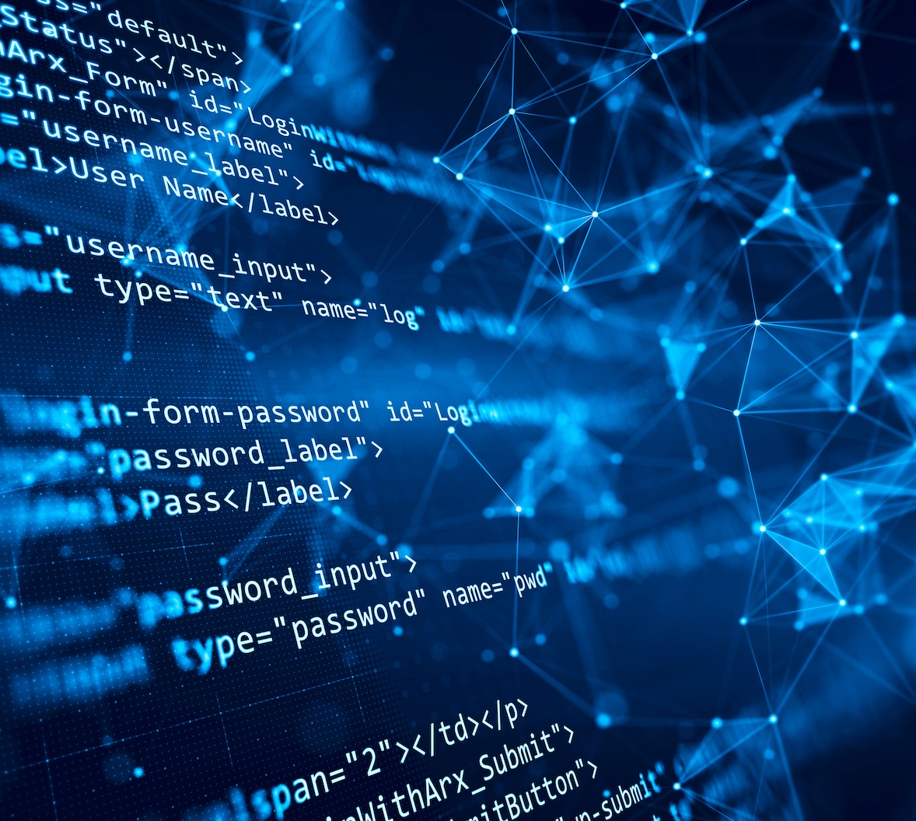

Team 55: Research Lab Inventory Tracker
Bi-Weekly Update 1 Lizzett Tapia Sumedha Bhattacharyaa Jonathan Moore Evan Ross TA: Niloofar Borzooei
Notes:
Michelle

Slide 2
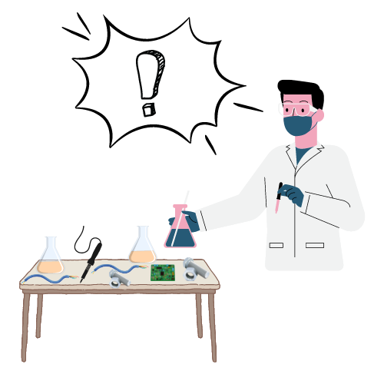
Problem Statement
“The current lab inventory tracking systems at Texas A&M are inefficient, and it is necessary to create new, organized software to increase the overall performance and efficiency of the Lab.”

Slide 3
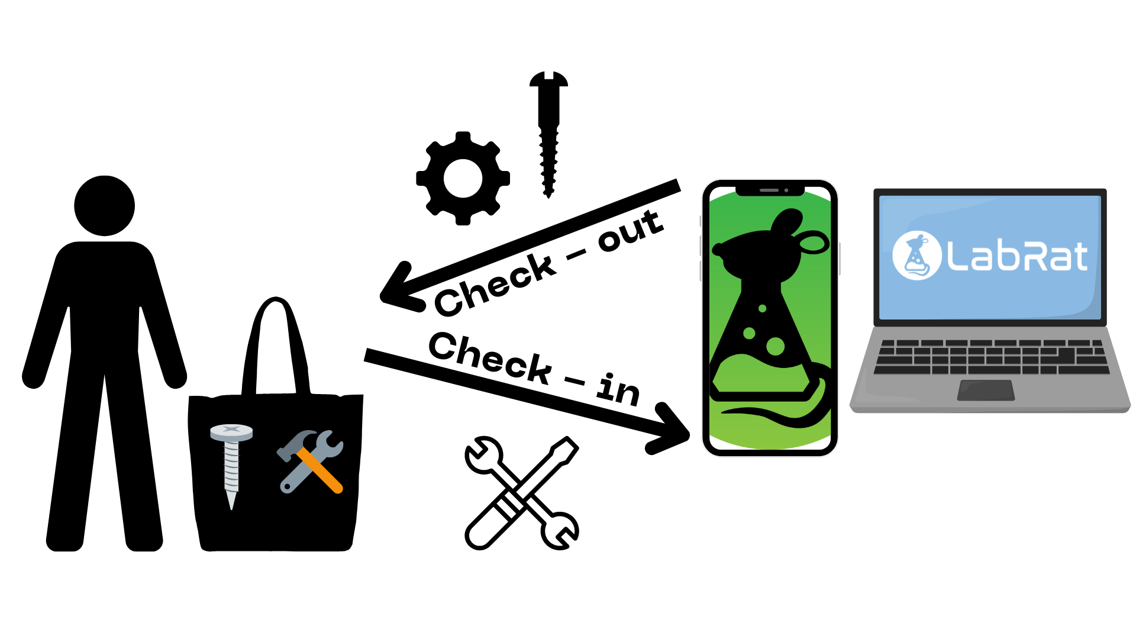
Solution Proposal
“Develop a web and mobile application integrated with a database to streamline inventory management in TAMU labs. The mobile app uses a machine learning-based image classification system to allow users to easily check items in and out by scanning them.”

Slide 4
Interaction of Subsystems
Database
Web-App
Mobile App
Machine Learning Model
Jonathan Lizzett Sumedha Evan

Slide 5
Task Partitions pt. 1
Lizzett: Develop a database server that stores, manages, and provides access to inventory data for users.
Jonathan: Create a web-based application for users to interact with the database through a graphical user interface and search engine.

Slide 6
Task Partitions pt. 2
Sumedha: Implement a Machine Learning Model that will allow - on the app - for the use of cameras on a mobile device to scan items, and check them back into the lab inventory.
Evan: Create a mobile application with similar function to the website. Users can interact with the database through the mobile UI. App will utilize the camera for the machine learning component.

Slide 7
Major Project Changes for 404
Increased collaboration across subsystems
Ensure that the data server, website, app, and ML Model are one cohesive system
Consistency between components
Make sure that the categories between all subsystems are consistent
Integration Testing and Debugging
Shift towards testing and debugging for the system as a whole
System Scalability and Usability
Focus on refining user experience and scalability, ensuring the system can handle more users
Lessons from Last Semester
If needing help hosting any subsystem, get a reliable solution as soon as possible
Notes:
Eric

Slide 8
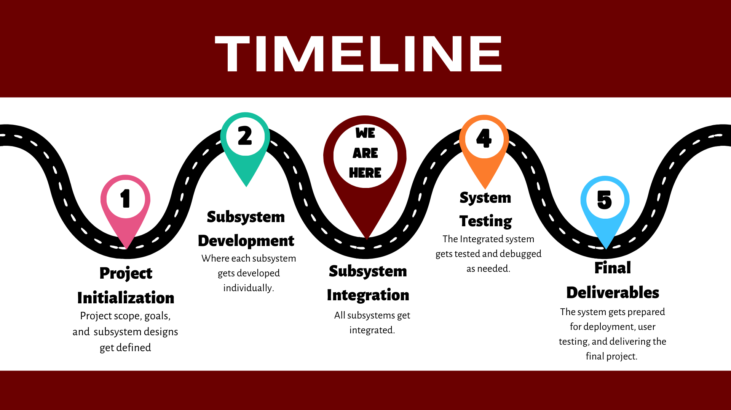
Notes:
Eric

Slide 9
Website
Jonathan
Accomplishments since 403 4 hrs of effort | Ongoing progress/problems and plans until the next presentation
Minor fixes to user interface. | Hosting the website online instead of locally has had issues, but I have found a new service and it is going better

Slide 10
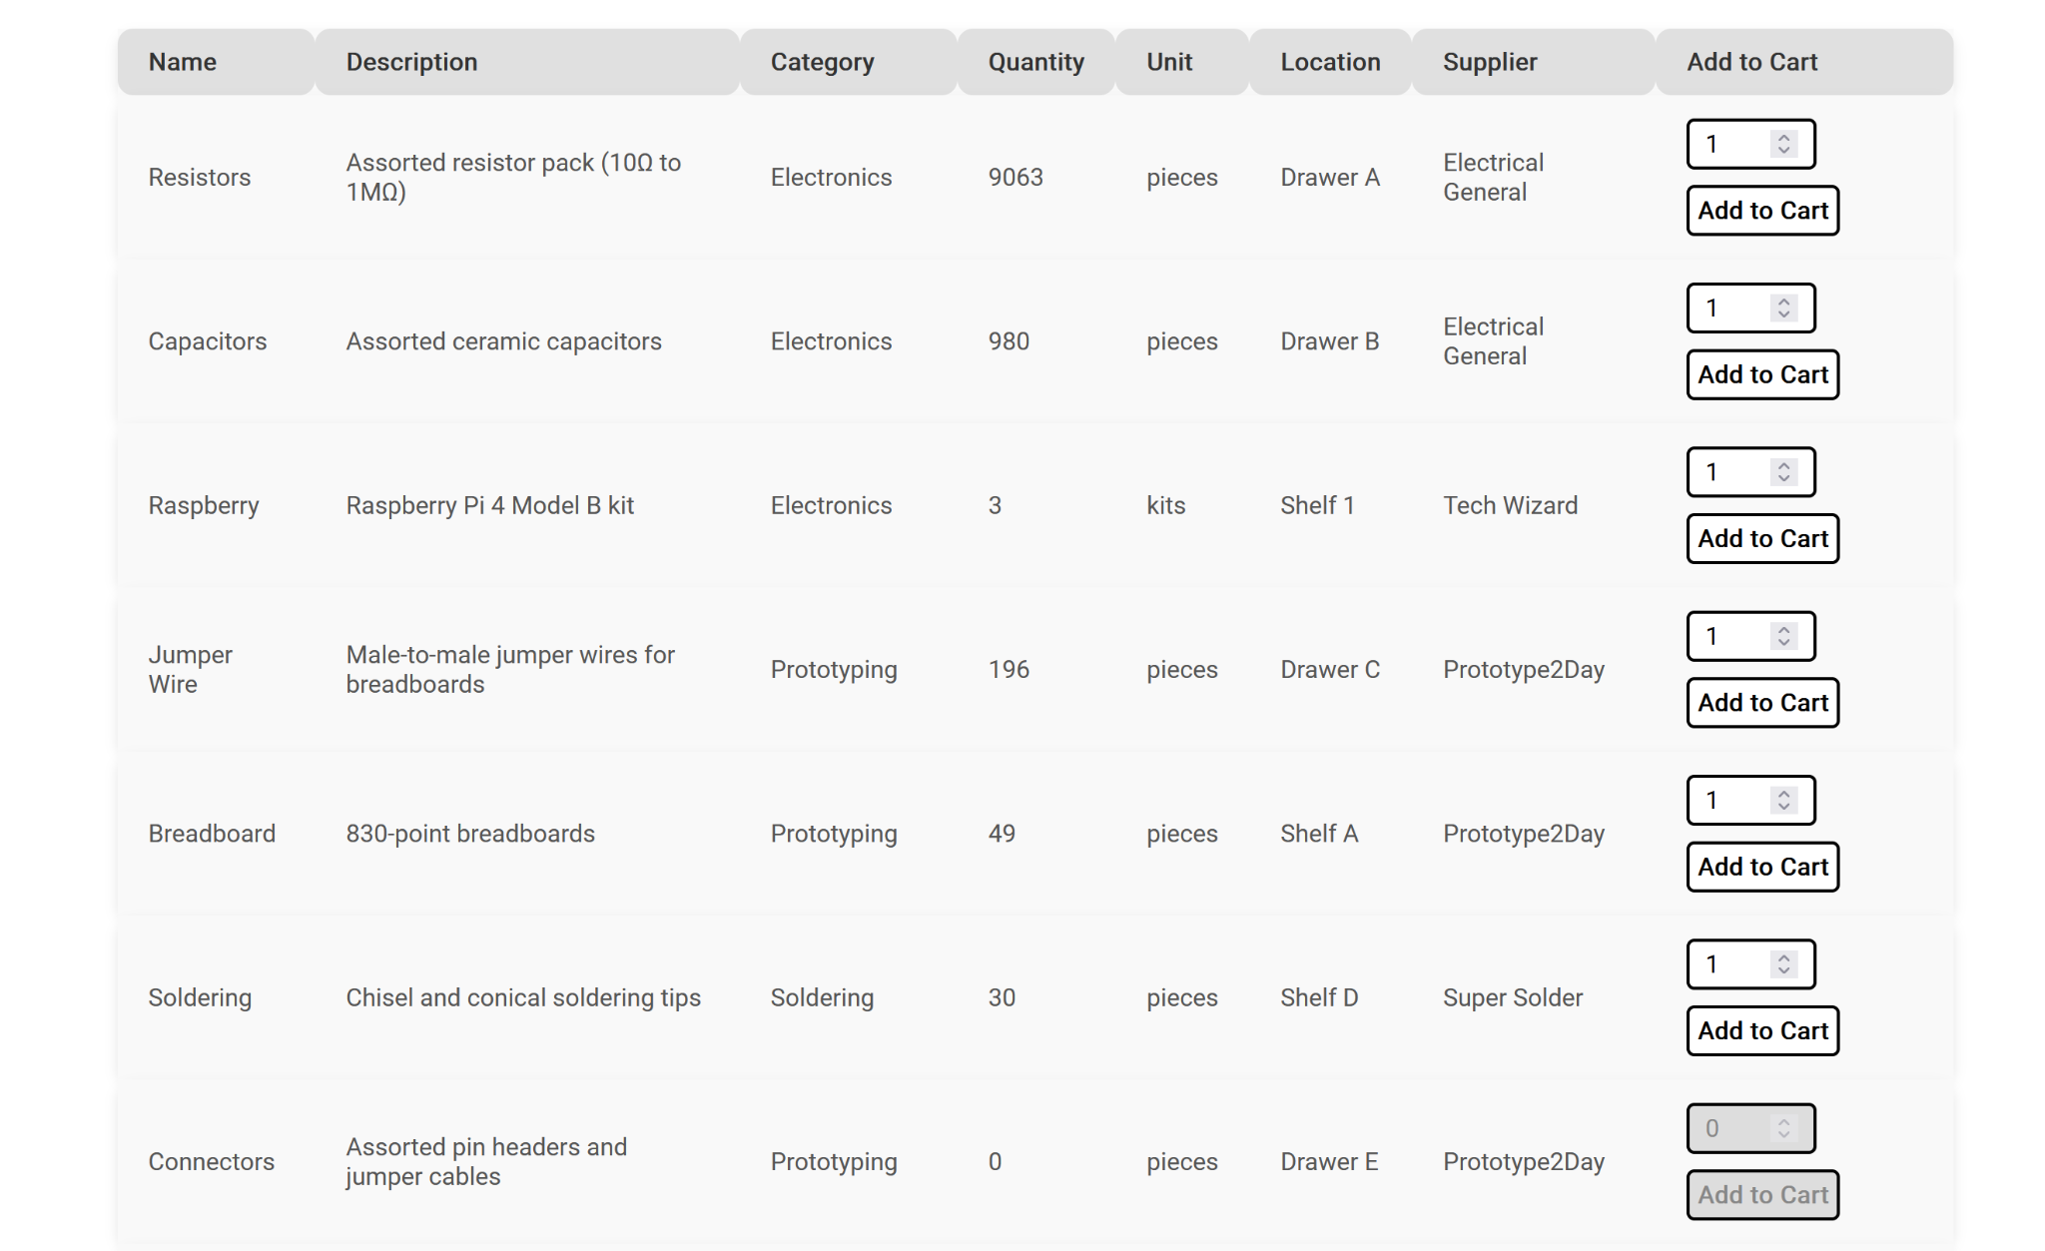
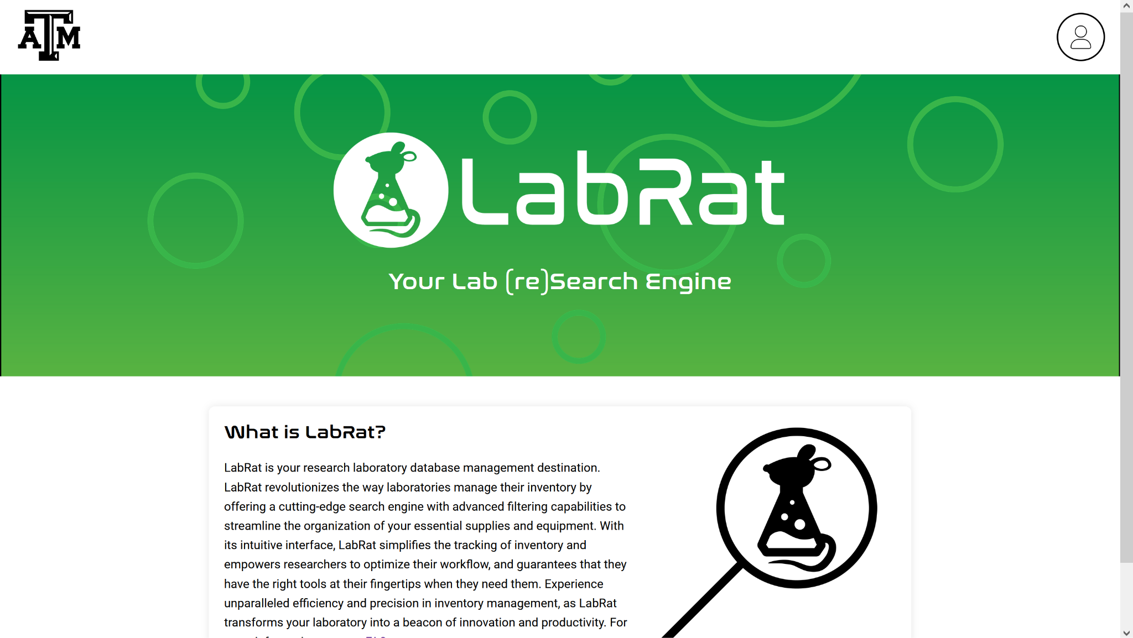
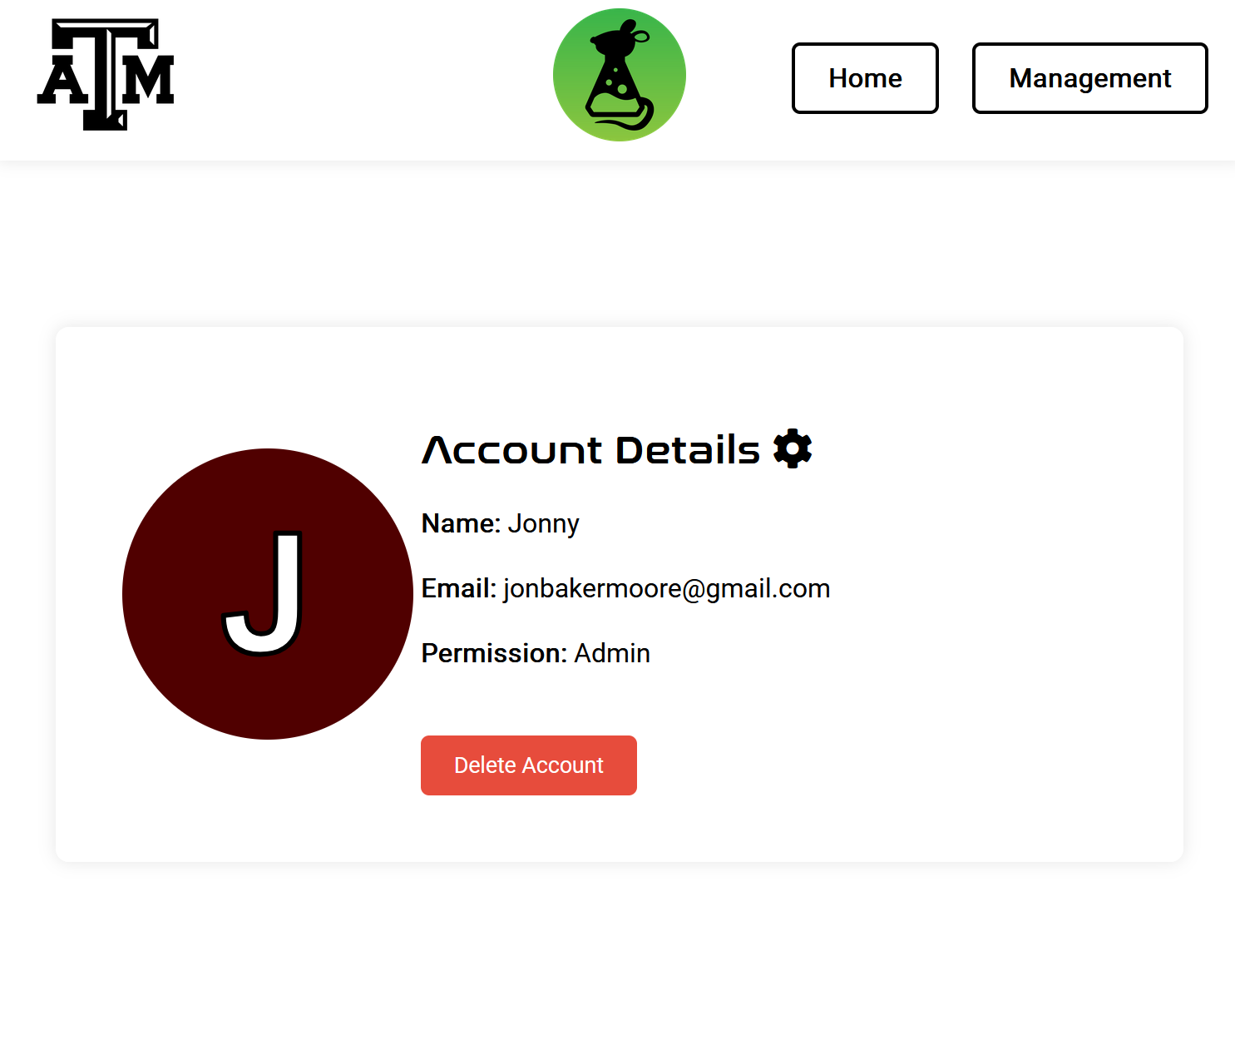
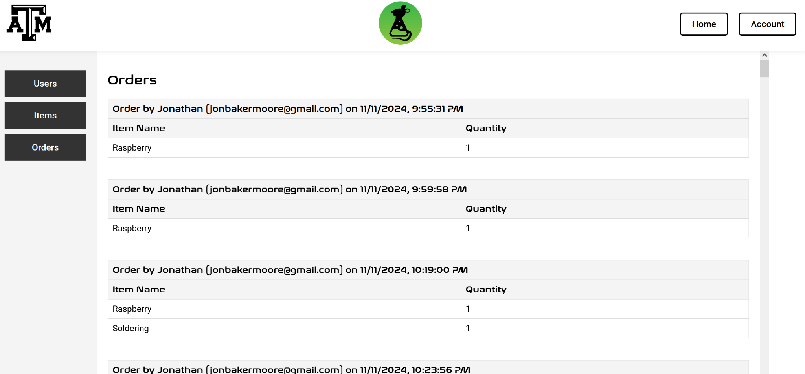
Website
Jonathan

Slide 11
Machine Learning Model
Sumedha
Accomplishments since 403 2.5 hrs of effort | Ongoing progress/problems and plans until the next presentation
Made minor adjustments to datasets Reran the completed model | Adding extra datasets to align with the dataserver and app’s categories Save the model in a PyTorch or TensorFlow format for deployment Upload to GitHub with detailed instructions

Slide 12
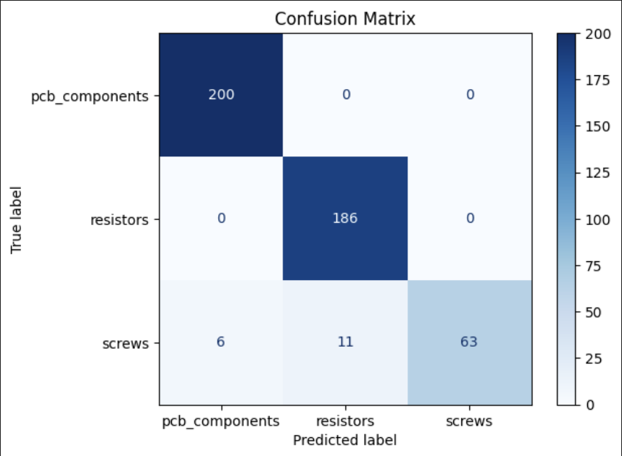
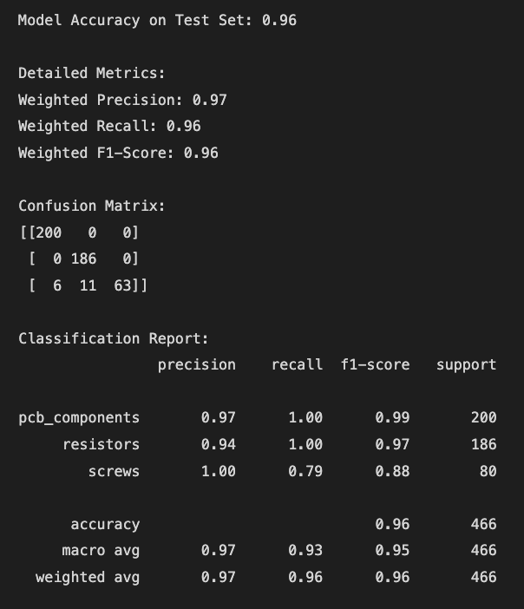

Slide 13
App
Evan
Accomplishments since 403 4 hrs of effort | Ongoing progress/problems and plans until the next presentation
Ran the app on simulated phone as well on actual phone to ensure functionality Created ongoing todo List | Edit flutter application and local database tables to have the same column and variables as external database Research creating a backend to link flutter to database and ML model

Slide 14


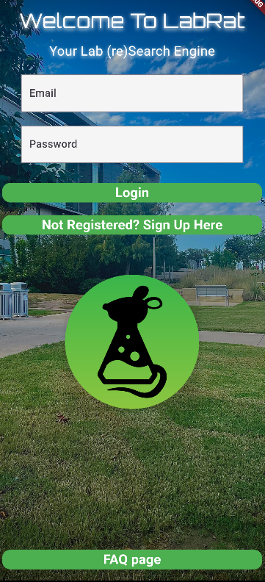
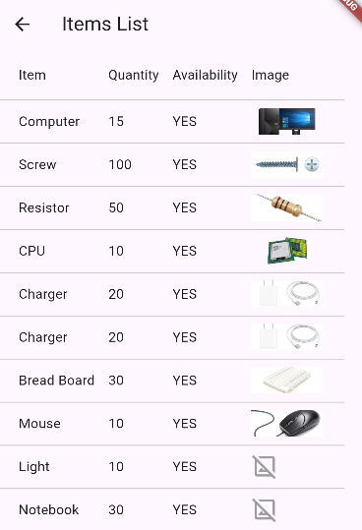
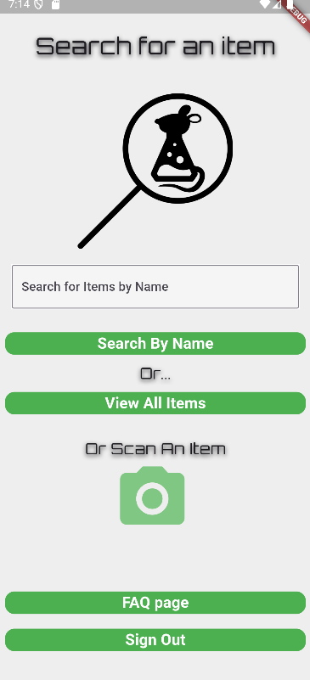
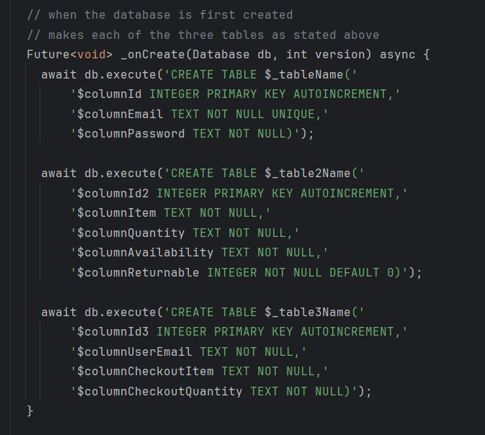
App
Evan
User Interface Is essentially done for the time being. The priority shifts to linking to external database and ML model.

Slide 15
Database Server
Lizzett
Accomplishments since 403 2.5 hrs of effort | Ongoing progress/problems and plans until the next presentation
Reran the database and went through the validation plan from 403 Have an understanding on how to go about connecting the database to app & website | Begin establishing a proper connection to the app & website Make sure that any inventory changes completed on app or website updates on the database

Slide 16
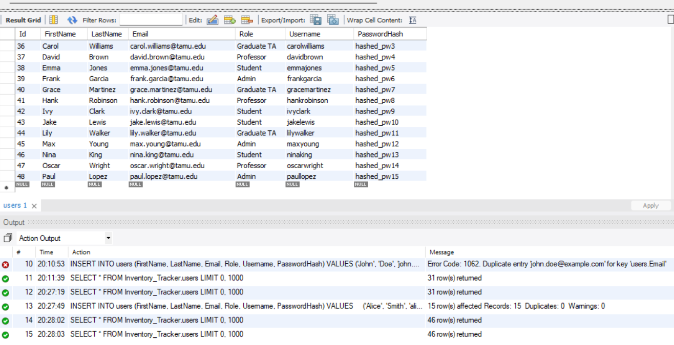
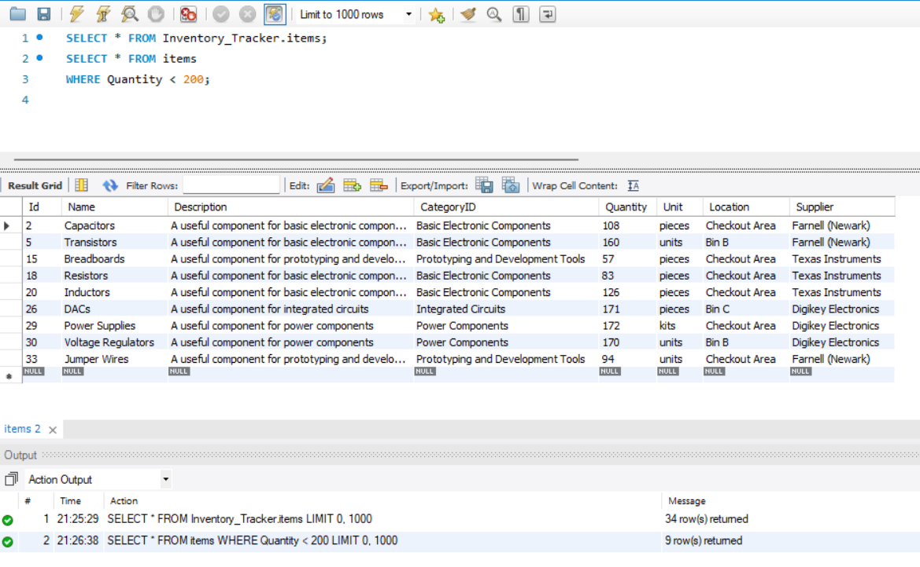
Data Server
Lizzett

Slide 17
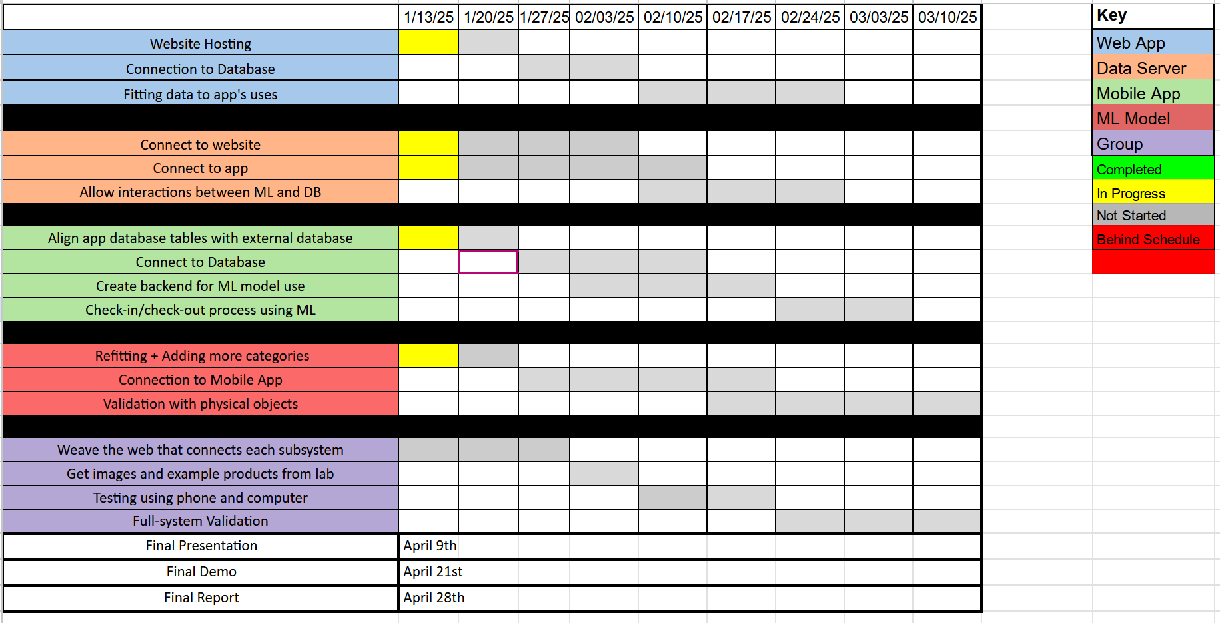
Execution Plan
Notes:
Michelle

Slide 18
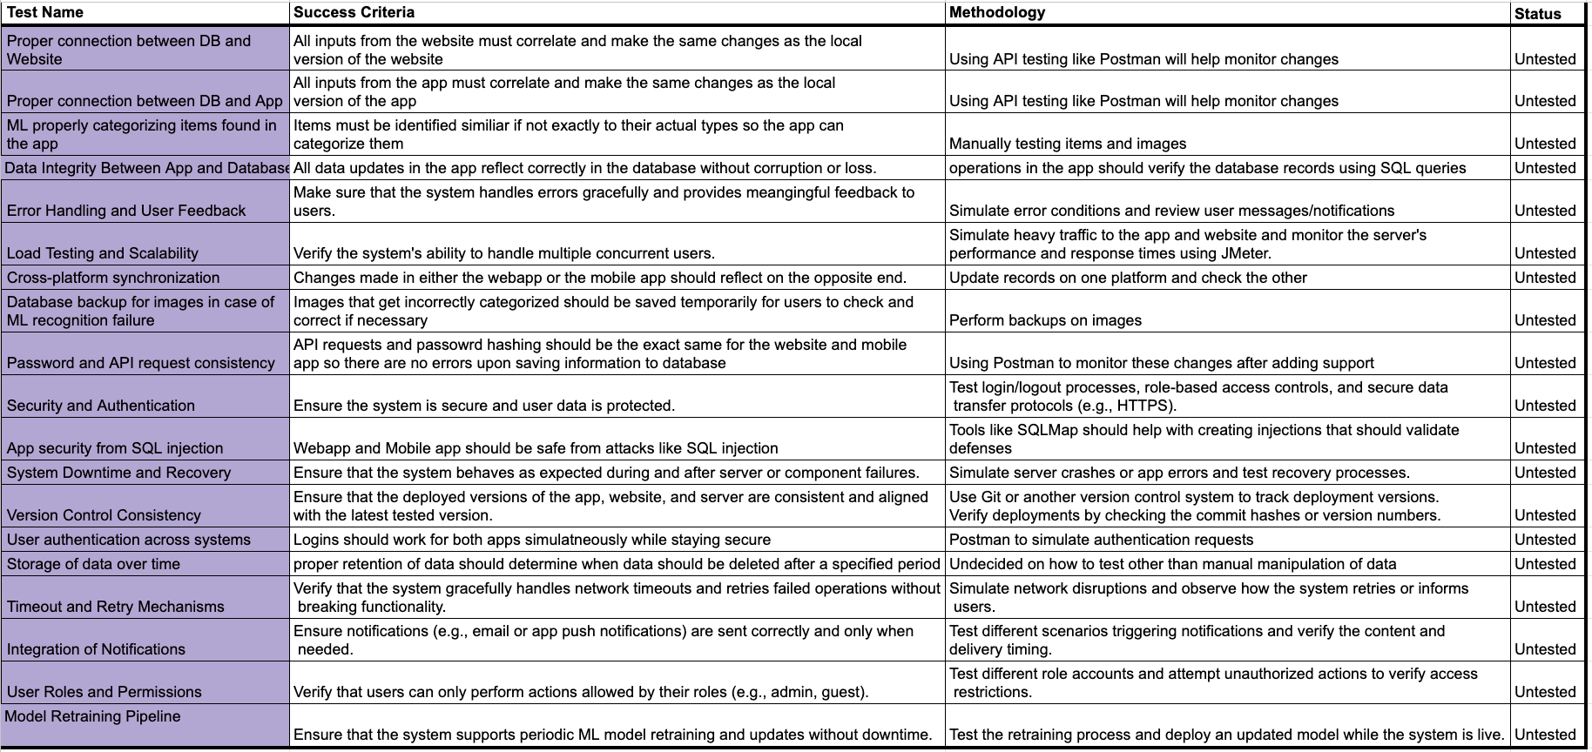
Validation Plan
Notes:
Michelle

Slide 19
Thank You For Listening!

